Slide 1
Highly time resolved characterization and source apportionment of particulate elemental composition in Zürich
M. Manousakas*, M. Furger, G. Chen, P. Rai, L. Qi, A. Tobler, F. Canonaco, K. Dällenbach, J. Slowik, I. El Haddad, A.S.H Prévôt
22nd Task Force on Measurement and Modelling Meeting

Slide 2
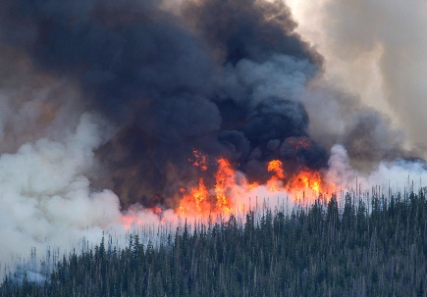
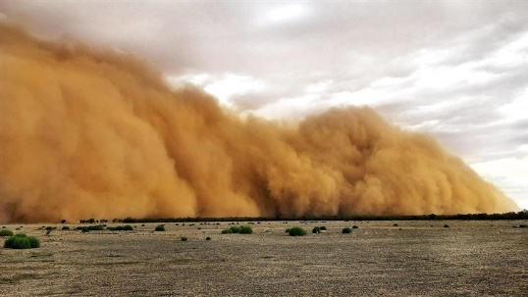

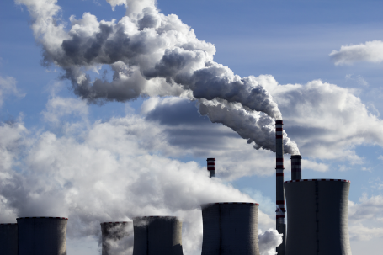
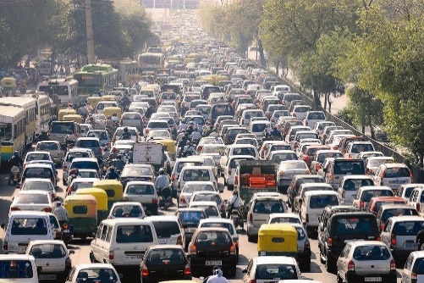




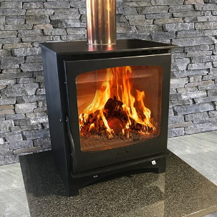

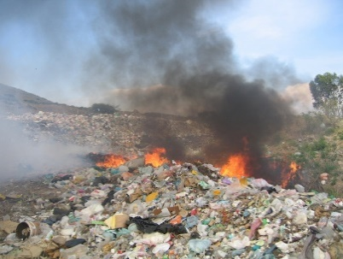
Motivation
Emissions that occur inside urban agglomerations have similar chemical fingerprints and emission patterns
It is challenging for SA models to identify and distinguish them
Successful mitigation measures and application of novel techniques only possible with optimized SA results in urban areas
Natural sources
Anthropogenic sources

Slide 3
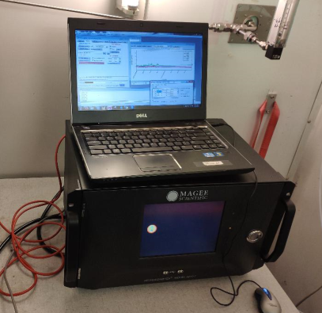
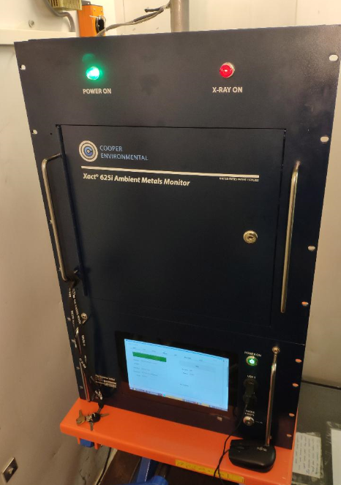
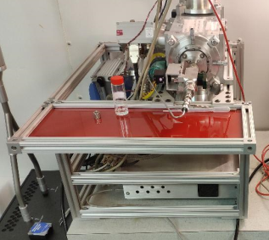
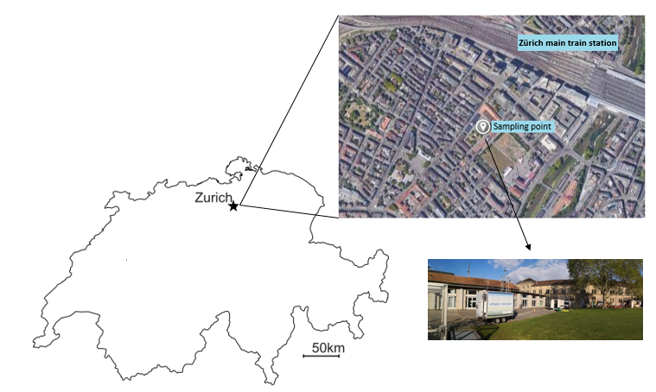
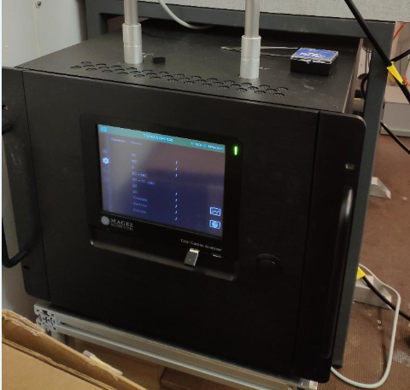
Project objectives
Optimization of SA (both organics and inorganics) is important
Identify PM sources using high-time resolved size segregated elemental concentrations
Xact
Aethalometer
ACSM
Sampling, analysis, and near real-time reporting
of PM elemental composition of the selected PM fraction in time resolution ranging from 15 to 240 min
TCA

Slide 4
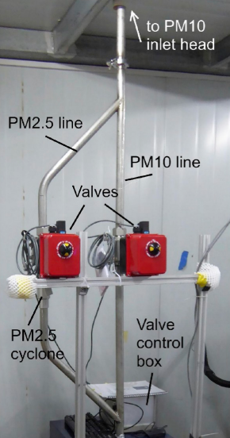
Input matrix
Xact
1h PM₁₀
1h PM_{2.5}
+
1h PM₁₀
1h PM_{2.5}
-
Linear interpolation to 1h
Linear interpolation to 1h
PM₁₀
PM_{2.5}
PM_{coarse}
SA dataset

Slide 5
Overview

Slide 6
Data acquired

Slide 7
PMF results
Results to be published soon, please do not distribute

Slide 8
Source profiles
K/S = 2.74
Mn/Fe = 0.03

Slide 9
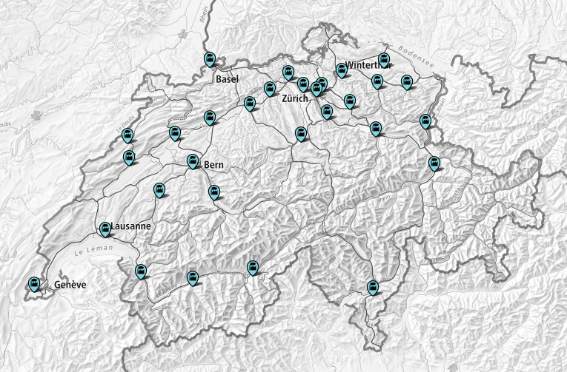
Source profiles
Railway Mn/Fe ratio in the factor is 0.03, relatively close to a Mn/Fe ratio of 0.01
In fireworks the ratio K/S in the factor equals 2.74, which is in excellent agreement with the elemental concentration ratio of K and S in black powder (2.76) (Dutcher et al., 1999)
In fireworks the Ba/K ratio of 0.055 is also in good agreement with the proposed ratio of 0.057 (Pongpiachan et al., 2018)
Bukowiecki et al., 2009 showed that more than 75% of the brake wear emissions from heavy-duty vehicles were found in the coarse mode (2.5-10 µm)
Zn and Pb can be emitted by waste incineration. According to data from the Swiss Federal Office of Energy, in 2017, Switzerland had 30 municipal waste incineration plants (MWI)
https://map.geo.admin.ch

Slide 10
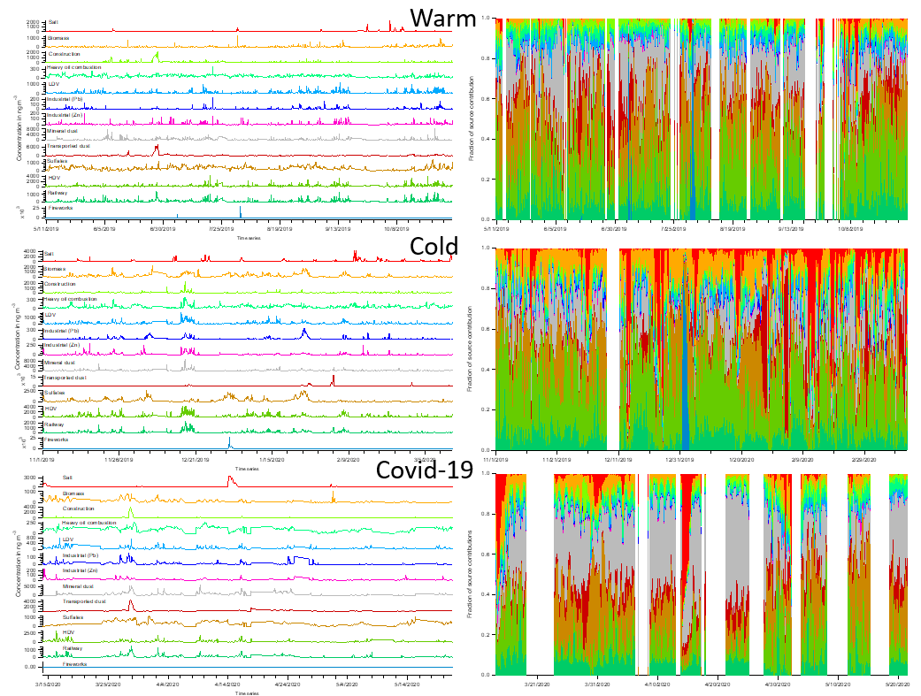
Source contribution time series

Slide 11
Source contributions

Slide 12
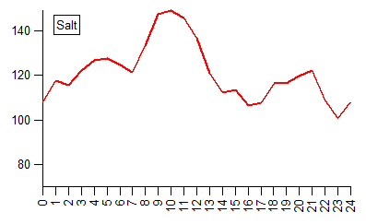
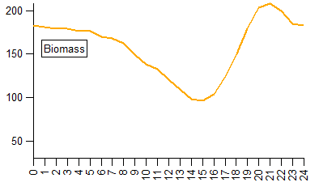
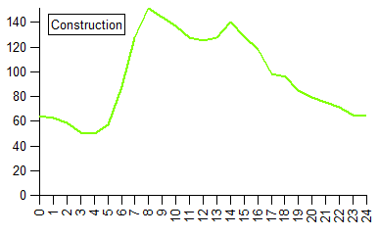
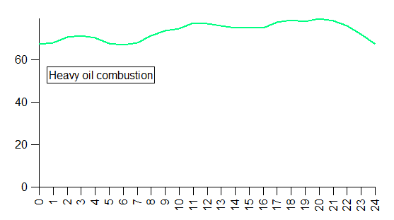
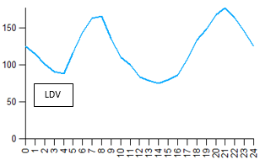
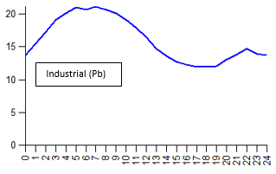
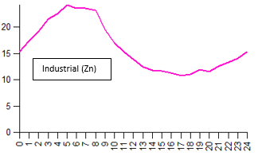
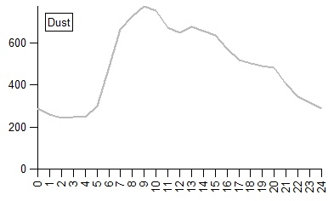
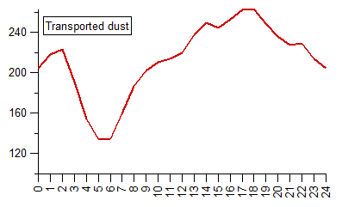
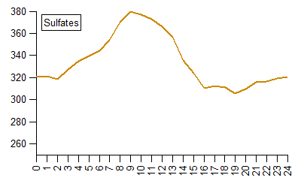
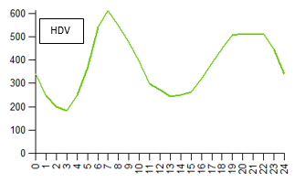
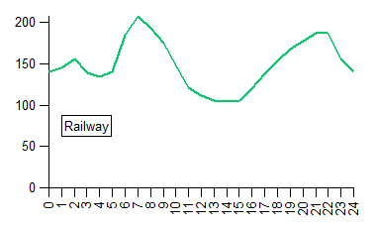
Source contributions diurnal variations
Salt
Biomass
Construction
Heavy oil combustion
LDV
Industrial (Pb)
Industrial (Zn)
Dust
Transported dust
Sulfates
HDV
Railway

Slide 13
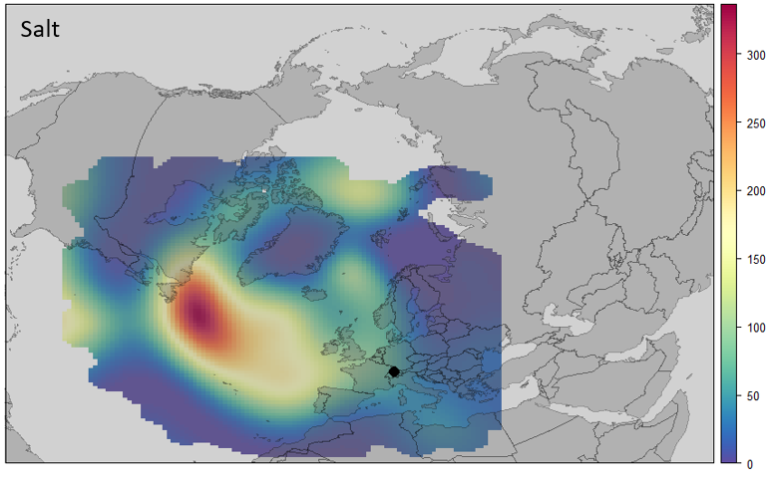
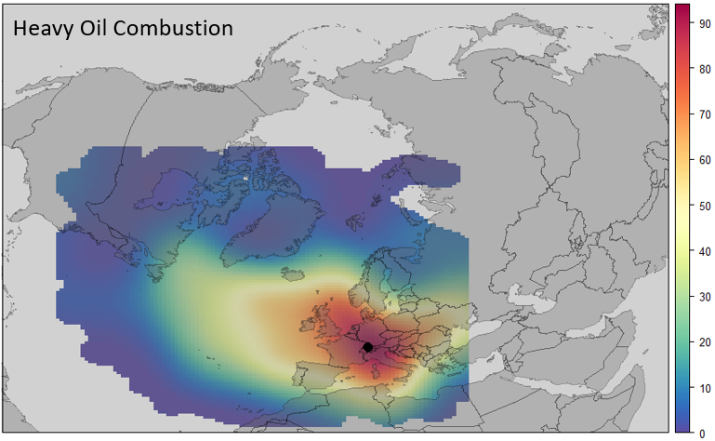
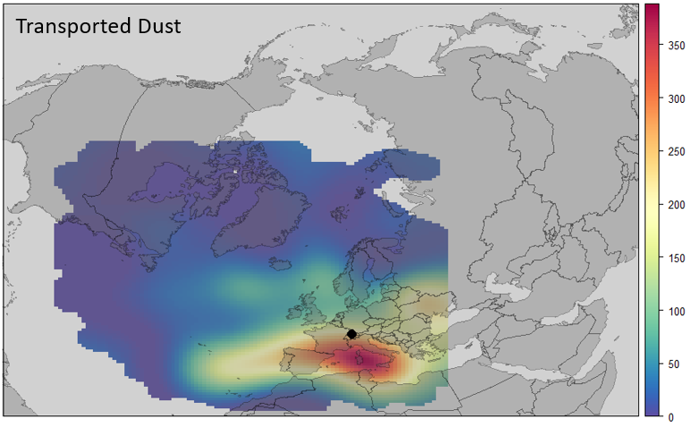
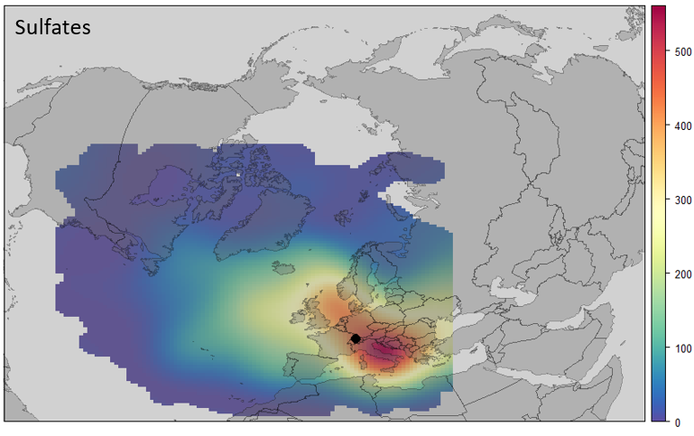
Concentration Weighted Trajectories

Slide 14
Conclusions
The combination of the inlet switching system and the SA approach yielded improved PMF results for Zürich, Switzerland
A clear advantage of this approach is that the model, additionally to the diurnal and temporal variation of the dataset, also utilizes the variation from the size segregated data
The methodology needs to be tested using long-term data from other areas with more frequent pollution events, that may create complications to the interpolation procedure
Optimization of SA (both organics and inorganics) is important as we are moving more and more towards real-time options
Combining data from different instruments (Xact, ACSM, aethalometers). Sites with such instruments in continuous base already in Europe

Slide 15












Wir schaffen Wissen – heute für morgen
Many thanks to:
Empa/NABEL for technical support and resources
This study was supported by the Swiss Federal Office of the Environment (FOEN)

Slide 16
Back up slides

Slide 17
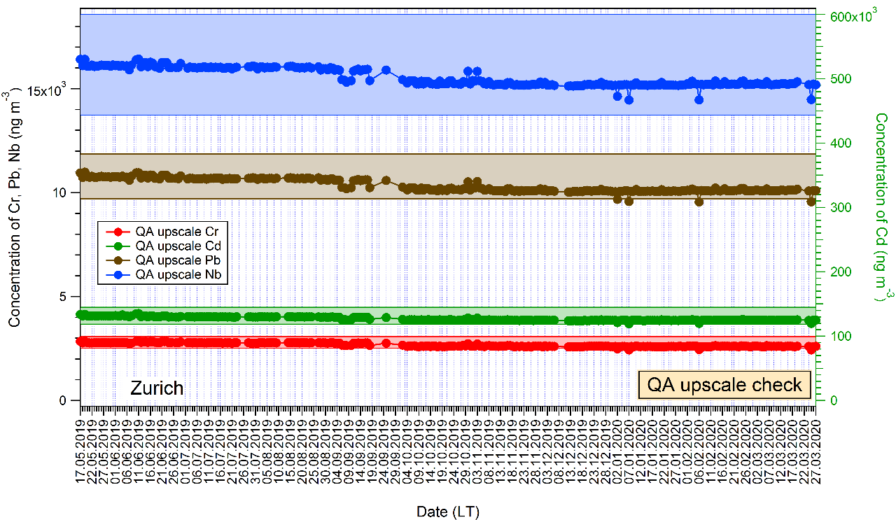
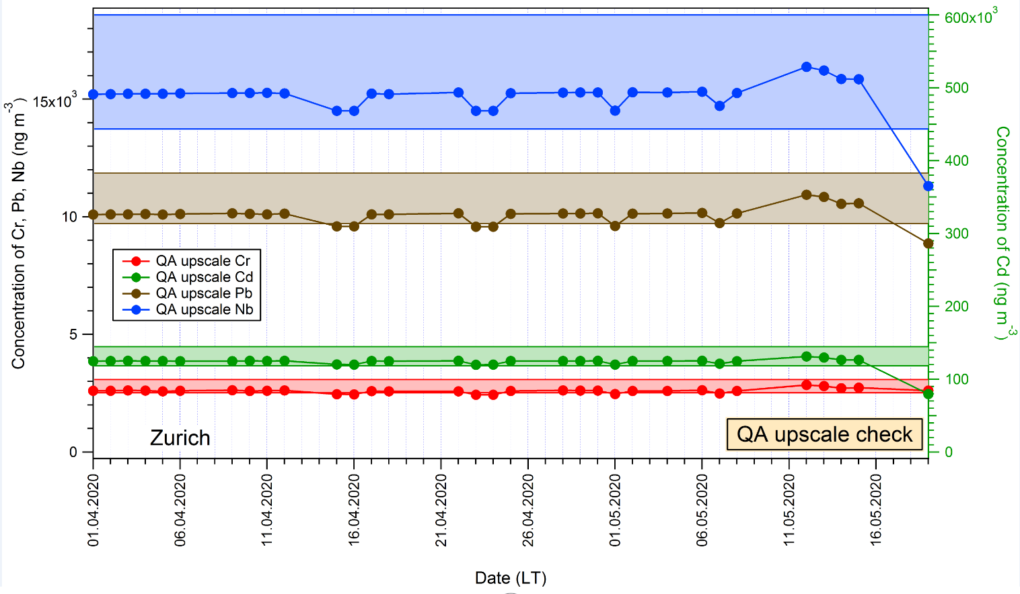
Xact 625i instrument stability
May 19 – May 20

Slide 18
Correlations to external data

